Slide 1
Type and Typography
EDC&I 583
Message Design
11 January 2012

Slide 2
Questions from Last Week
Do you always use the default font on your word processing program? If you use different ones, how do you choose, and for what purpose (effect)?
When/where (in your experience) does typography make a difference?
Examples of books, web sites, other materials where typography facilitated or hindered learning?

Slide 3
Tufte and Williams
Tufte:
What’s involved in learning to read the kinds of graphics he shows? (Scale, size, relationship, etc.)
Any case(s) when you’ve tried to show/teach someone how to read these (or tried yourself to understand) without success?
Williams:
His “Redesign” examples (pp. 168-189) – do the redesigns grab you more than the originals?

Slide 4
In the Beginning…
Writing systems and the advent of literacy
Slow spread until 18th c. in Europe, 20th c. in many parts of world
Reading ≠ writing (more could read than write)
But: Over time, the technique of representing the “world on paper” became definitive

Slide 5
Need to Generate Written Texts
Initial efforts: Primarily commercial and religious
Cuneiform tablets, Phaistos Disk, Egyptian papyri, Mayan astronomical tables
Dresden Codex ⇒

Slide 6
Ong¹, “Psychodynamics of Orality”
In an oral culture, retaining and passing along information is difficult
Therefore, “you know what you can recall”
Heavy reliance on formulas, mnemonics
Expression in general tends to be
Additive rather than subordinative
Aggregative rather than analytic
Redundant or "copious“
Conservative or traditionalist
Close to the human lifeworld
Agonistically toned
Empathetic and participatory (rather than objectively distanced)
Homeostatic (“in the present”)
Situational rather than abstract.

Slide 7
Olson², The World on Paper
Writing brings spoken language into consciousness
Makes it subject to reflection, design
No writing system brings all of what is said into consciousness
How things are said, whether literally or metaphorically, etc.
Texts provide only an approximate indication of a speaker or writer’s intention
It’s difficult for an “alphabetic literate” to understand how a non-literate person experiences language
Expressive and reflective powers of speech, writing are complementary rather than similar
Becoming literate allows (requires) the reader to compensate
For example, interpret how something is to be taken
Learning to read text ⇒ learning to “read nature”
“Concepts for representing how a text should be taken provide the concepts necessary for the representation of mind.”

Slide 8
Gutenberg
Goldsmith Mainz Germany ca. 1398-1468
Put together various processes to create “printing as we know it”
Cf. Steve Jobs
Press – molds – punches – ink – etc.
BUT: What did he actually invent…?

Slide 9
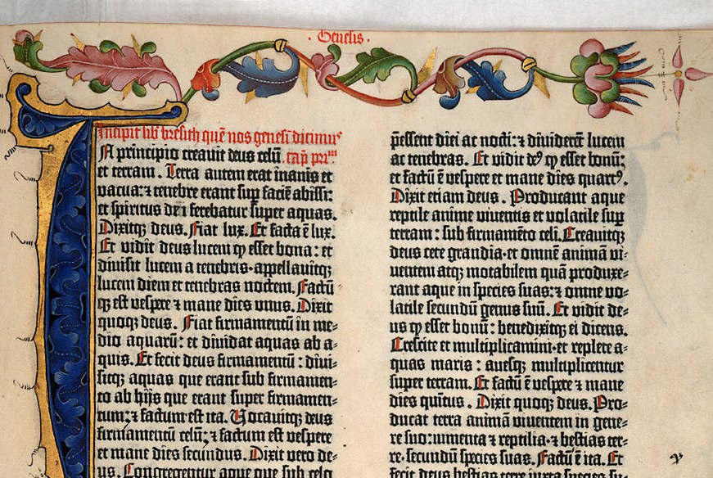
The Gutenberg Bible
The “42-line Bible”
Produced 1450-55
Intended to look like scribally produced books of the time
“What did Gutenberg actually invent?”
Rapid spread throughout Europe

Slide 10
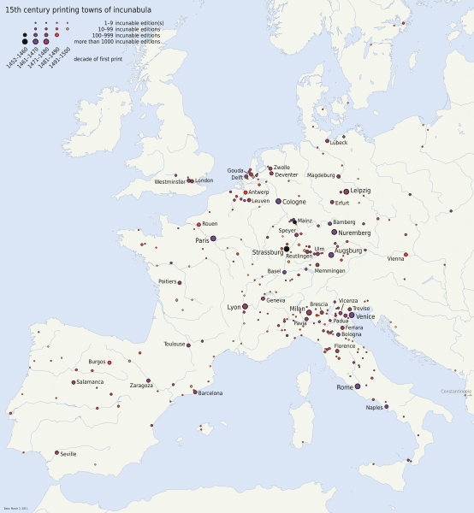
Incunabula
To 1500
Rise of particular towns, families
Varying laws on control of presses, printers, etc.

Slide 11
Type and Typography – Developments
Emergence of distinct font “families” (see Lupton, Williams)
Gradual move towards more simplicity (fewer complex ligatures, simpler letter forms, etc.)
Gradual appearance of “wayfinding aids” we now take for granted³
Paragraphs, spacing, title pages, chapter and page headings, page numbers, tables of contents, indices, appendices, etc., etc.

Slide 12
What Did Printing Do? To our ways of thinking and seeing the world?
Elizabeth Eisenstein, The Printing Press as an Agent of Change⁴
Cheaper, faster dissemination of knowledge
Democratization of access (schools, libraries)
Codification of information (almanacs, tide tables, etc.)
Record keeping and organization skyrockets (aids bureaucracy and strong central government)
Collect, share, compare information (scientific revolution)
Rise of the “canonical” text
Distinction between “original” and “fakes,” “copies”
Notion of distinct authorship and IP rights ⁵

Slide 13
What About Type Itself?
Most research on type doesn’t show large differences
Except with extreme fonts, unusual/stressful conditions
Many studies conducted for military applications in WW II and after
Legibility, reaction time, discrimination of labels, etc. = key

Slide 14
Does Typography Matter?
Sometimes – odd letter forms slow people down, force more attention to delivery, less to content
Archaic “Black Letter” type faces
The inimitable Comic Sans
Any “script” typeface
Key features of any type face: ascenders, descenders, x-height

Slide 15
Some Critical Points
Most studies support using sans-serif faces (like this one) for short or bulleted text
And serifed faces like this one for longer passages
But the differences aren’t large in most cases (cf. Waller 2007)

Slide 16
Upper or Lower Case?
Easier to read longer passages if use both upper and lower case
All-caps = OK for short passages, labels
LC lettering has more distinguishing information, hence eases comprehension

Slide 17
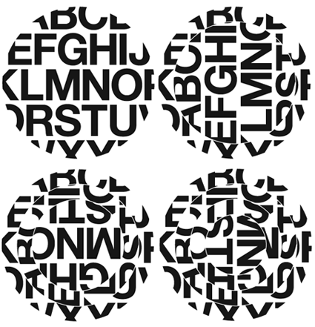
Be Aware …
Of what’s in your environment, typographically!
Likely there’s a lot of
HELVETICA*
* Just not on this computer!

Slide 18
What’s Key Other than Type?
Spacing!
Between lines, around text (top and bottom of pages, margins (cf. Hartley’s “page grid”)
Column widths
Color
If you use it, be consistent!
Readers assume that things like color, headers, other graphic elements have meaning (and they’ll provide it if you don’t!)

Slide 19
References
¹ Ong, W. (1982). Orality and literacy: The technologizing of the word. New York: Methuen.
² Olson, D. (1994). The world on paper. New York: Cambridge.
³ Febvre, L., & Martin, H-J. (1958/1976). The coming of the book.: The impact of printing, 1450-1800. London: Verso.
⁴ Eisenstein, E. (1979). The printing press as an agent of change: Communications and cultural transformations in early modern Europe. New York: Cambridge.
⁵ Johns, A. (1998). The nature of the book: Print and knowledge in the making. Chicago: U. of Chicago Press.

Slide 20
Questions for Next Week
When do text organization and layout make a difference?
On your word processor, do you use default settings for inter-line spacing, indentations, etc.? Why/why not/where not?
How well do the forms of text organization and design suggested in Souto, Cromley, translate into online environments?

